Slide 1

An Analysis of Upgradeability, Oracles, and Stablecoins in the Ethereum Blockchain
(Master thesis defense)
Mehdi Salehi
Supervised by:
Dr. Jeremy Clark
Dr. Mohammad Mannan
Department of Information Systems Security
Faculty of Engineering and Computer Science
Concordia University
April 2022
Notes:
Good Afternoon. My name is Mehdi Salehi, and welcome to my thesis defense. This thesis is supervised by Dr Clark and Dr Mannan.

Slide 2
Publications
Not So Immutable: Upgradeability of Smart Contracts on Ethereum
Salehi, M., Clark, J., & Mannan, M. (2022, May). Not So Immutable: Upgradeability of Smart Contracts on Ethereum. In WTSC Workshop, co-located with International Conference on Financial Cryptography and Data Security.
Sok: Oracles from the Ground Truth to Market Manipulation
Eskandari, S., Salehi, M., Gu, W. C., & Clark, J. (2021, September). Sok: Oracles from the ground truth to market manipulation. In Proceedings of the 3rd ACM Conference on Advances in Financial Technologies
Red-Black Coins: Dai Without Liquidation
Salehi, M., Clark, J., & Mannan, M. (2021, March). Red-Black Coins: Dai without liquidations. In DeFi Workshop, co-located with International Conference on Financial Cryptography and Data Security.
Notes:
These three papers are published based on the content of this Thesis.

Slide 3
What is Ethereum?
The world computer
A global decentralized platform for money
Programmable money
ETH is the second largest cryptocurrency
$350 billion market capitalization
Notes:
Let’s start by answering the question : what is Ethereum? Ethereum is a blockchain that is called the world computer.

Slide 4
Smart Contracts
Piece of code run on blockchain
Inherits properties of blockchain (e.g., immutability)
Differences between smart contracts (WEB3) and traditional codes (WEB2)
Notes:
Eliminate trusted third party
Have control over billions of dollars of funds
Ignoring them leads to major hacks We will show hacks happened because of this in next slides

Slide 5
Thesis Statement
Similar to cloud services for developers
But there are some nuances
Shed light in some of them:
Immutable smart contracts
Don’t have access to real world data
Payments are different
Notes:
Ethereum is very similar
Paying attention to these nuances is the most challenging part of blockchain development. As we said in the previous slide ignoring them will result in detremental effects.

Slide 6
Upgradeability of Smart contracts on Ethereum
Dealing with smart contract immutability
Notes:
In this part of the talk, I will focus on the immutability of smart contract and how to deal with them to bring upgradeability in the Ethereum smart contracts. I’ve also show how it will add centrality to the Decentralized applications.

Slide 7
Software Maintenance
1
2
Correct faults Fixing a bug
Small changes
Improve performance New functionalities
Upgrades
Updates
Notes:
In software engineering and software maintenance we have two important concepts: Updates happen when we need to correct faults or bugs.
But Upgrades happen to imporove code and add new functionalities

Slide 8
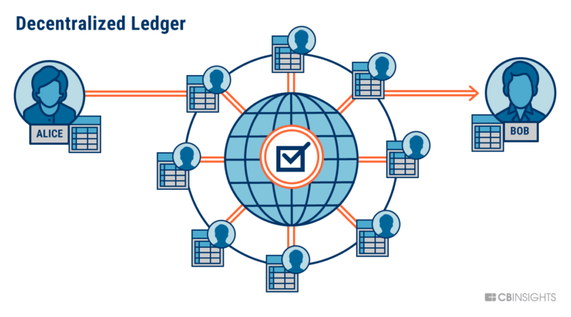

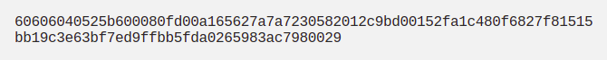
Smart Contracts
Pieces of software
Supposed to be immutable
Notes:
As mentioned in the previous slides smart contracts are pieces of byte code that supposed to be immutble
By immutable I mean no one can change them in the future

Slide 9

Immutable
A piece of software that you cannot change it!!!
It is worse in blockchains because code has control over money here
Notes:
But a piece of code that is not upgradeable is risky! In blockchains it’s even worse than traditional softwares because smart contracts have control over billions of funds in their custody

Slide 10
Upgradeability is a Bug!
How ?! (immutability)
No way! We need upgradeability
Who Is responsible?!

Slide 11
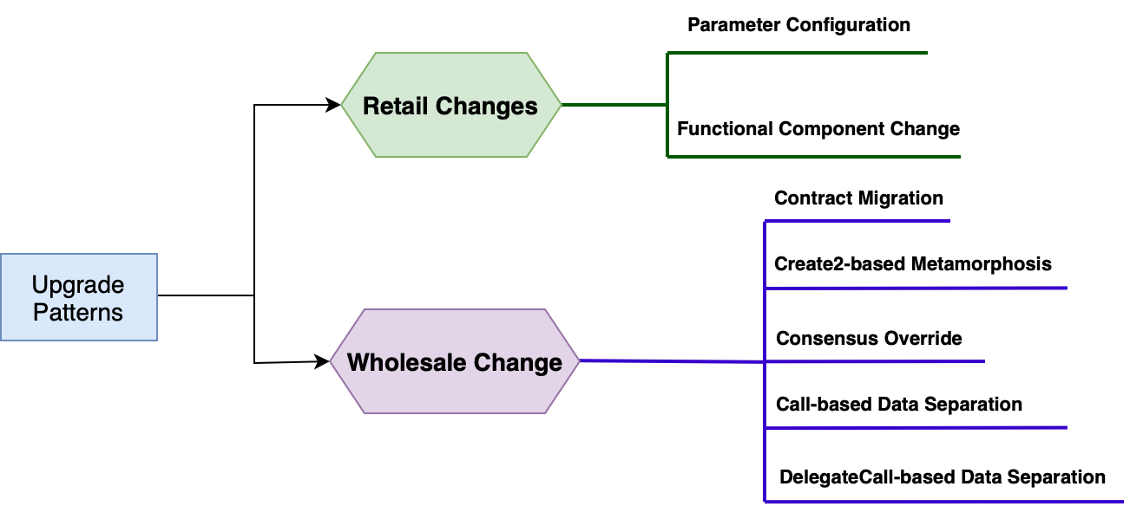
Upgradeability Patterns
Notes:
This is a big picture of different upgradeability patterns in Ethereum.
We classified different patterns into two main categories. Retail changes in which one can change a small pre-specified part of the Dapp. and Wholsale changes by which one can change the whole logic of the system.

Slide 12
Upgradeability Patterns
Notes:
In this talk we focused on the delegate-call based pattern which is the most popular pattern in Ethereum right now but in the thesis we explained all different patterns in detail.

Slide 13


Delegatecall-based Pattern
Send transaction
Delegate call
Storage (proxy)
Logic
(Implementation)
Delegate call preserves the context
Similar to copy pasting (not the same)

Slide 14
Delegatecall-based Pattern
Old logic
Send transaction
Storage (proxy)
Change target address
New logic
Notes:
In the upgrade event, admins must deploy a new contract and change the target address inside proxy, and let it know that it should delegatecall into a new address

Slide 15
Pros and Cons of Proxy Patterns
Pros
Can update the whole logic
No need to migrate data
Easy to add this pattern to regular code
User endpoint not changed
Cons
More expensive (gas overhead for txs)
Risks due to using Delegatecall opcode
Cannot change the state (data)

Slide 16
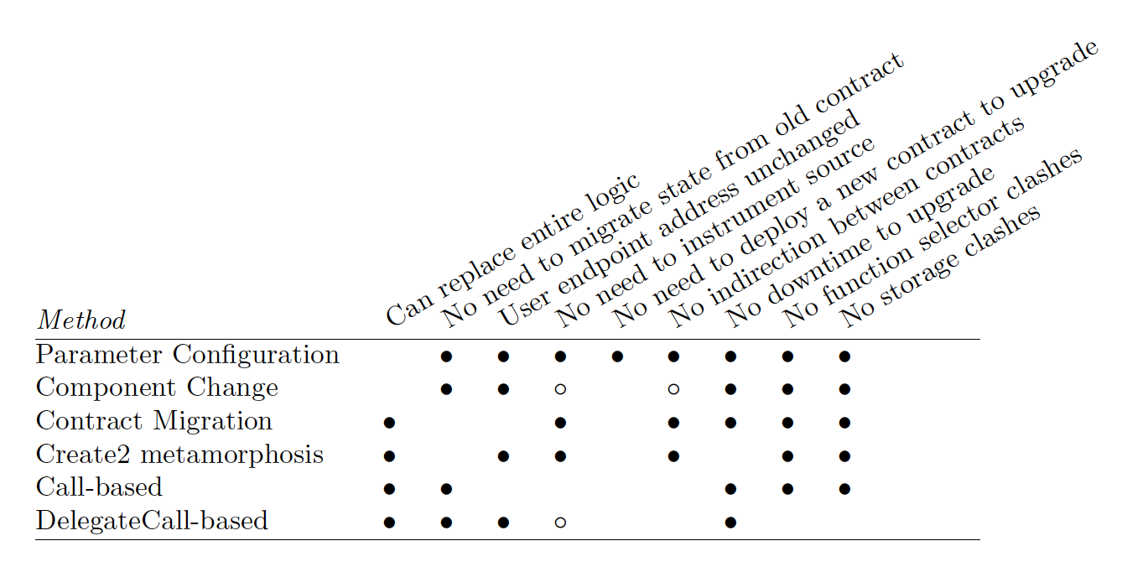
Evaluation of Different Methods
Notes:
We summarized all methods and evaluate them in the thesis.

Slide 17
Measurement Study for Pattern Identification
Find contracts that uses Delegatecall-based patterns.
It is mostly known as upgradeable proxy patterns
Notes:
Our Main Goal in this part is to find contracts that are using delegate call based pattern in the Ethereum blockchain.

Slide 18
Measurement Study for Pattern Identification
Transactions for 1 year
Replay transactions
Transaction traces
Full archival node
Notes:
To find the delegatecall based smart contracts, we use data of 1 year by getting the transaction traces of two million blocks of the Ethereum blockchain.

Slide 19
Delegate Proxy
Storage (proxy)
Implementation contract
Send transaction
address imp;
fallback () {
delegateCall to imp Forward the message
}
function upgrade (new_address){
imp = new_address;
}

Slide 20
Delegate Proxy
Storage (proxy)
Implementation Contract
Send transaction
address imp;
fallback () {
delegateCall to imp Forward the message
}
function upgrade (new_address){
imp = new_address;
}
Check find transactions pass this type of fallback

Slide 21

Delegate Proxy
Storage (proxy)
Implementation contract
Send transaction
address imp;
fallback () {
delegateCall to imp Forward the message
}
function upgrade (new_address){
imp = new_address;
}
Check find transactions pass this type of fallback
Proxy

Slide 22
Delegate Proxy
Storage (proxy)
Send transaction
address imp;
fallback () {
delegateCall to imp Forward the message
}
function upgrade (new_address){
imp = new_address;
}
Can we change Imp address?
Upgradeable

Slide 23
UUPS Proxies
Storage (proxy)
Implementation contract
Send transaction
address imp;
fallback () {
delegateCall to imp Forward the message
}
address imp;
function upgrade (new_address){
imp = new_address;
}

Slide 24



UUPS proxies
Try to find the upgrade function in implementation contract
Decompile
Yes
Implementation contract
No
UUPS proxy

Slide 25
Results
Proxy Contracts (Total) | 1,427,215
Proxy Contracts (Filtered) | 13,088
Regular Upgradeable Contracts | 7,470
UUPS | 403

Slide 26
Now: Who’s Responsible?
Externally Owned Address (EOA)
1 person decision
Multi Signature Wallet
M out of N person
Decentralized Governance
Governance token
Threshold on acceptance of a proposal

Slide 27
Who is the Decision Maker?!
Externally Owned Address (EOA)
1 person decision
Multi Signature Wallet
M out of N person
Decentralized Governance
Governance token
Threshold on acceptance of a proposal

Slide 28
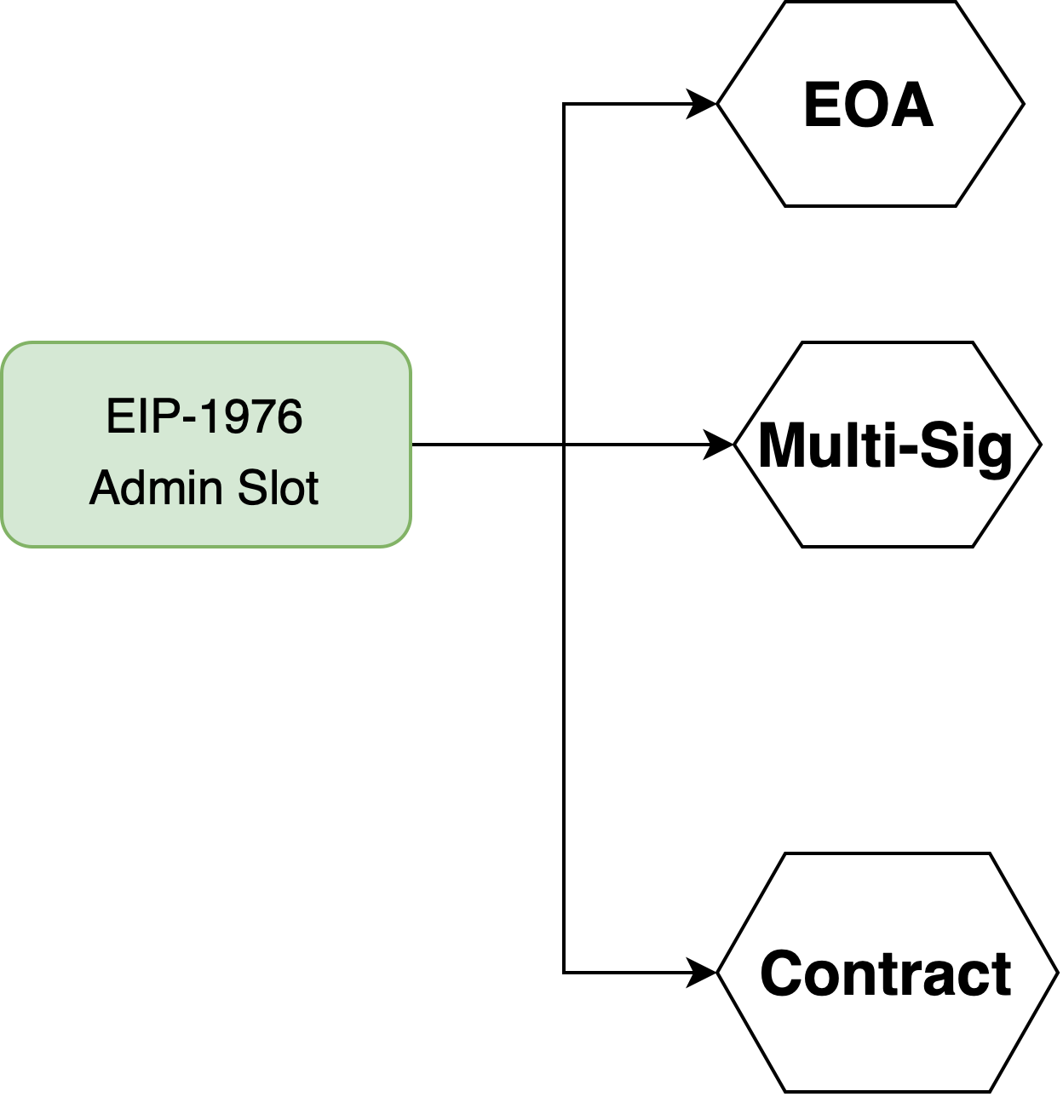
Admin Types
Using eth_getStorageAt method
No contract Code found
Admin Slot
Gnosis-Safe contracts
Others
Notes:
Here our goal is to find the type of admin of the 7.4k proxies we found in the previous part. First we find the place where admin address is saved by access control check. Then check that address that if it is an EOA or multi-sig or another type of contract.

Slide 29
Admin Types-Results
EOA : 3558
48%
7,470 Upgradeable Proxy Contracts
Multi-Sig : 988
13%
Governance/Other: 2924
Notes:
Totally out of 7.4k regular proxy contracts, 48 percent of them are controlled by just an EOA, and 13 percent by a Multi-sig wallet.
This is an alarm to the Ethereum community and ecosystem.

Slide 30
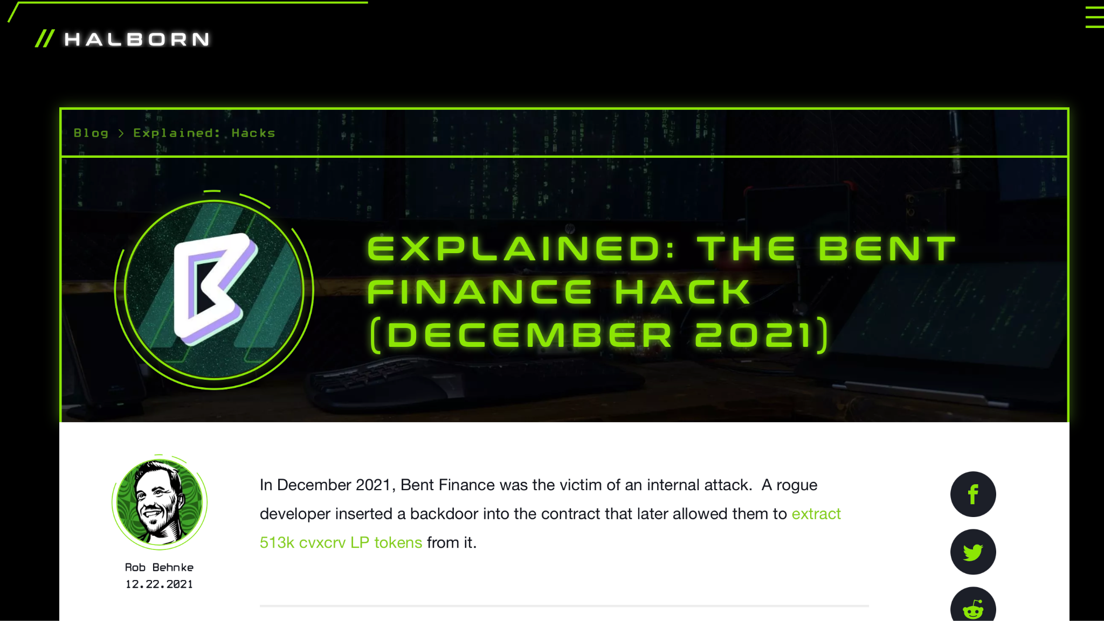
Admin Types-Results
EOA : 3558
48%
Multi-Sig : 988
13%
Governance/Other: 2924
Notes:
EOA admins are very dangerous because a single private key can decide to change the whole logic of the system.
A malicious or compromised EOA admin can decide to stop the Dapp, or even steal the fund.
There was an incident on bent finance protoco in December 2021l that the admin upgraded the system into a backdoored version and take benefit from it.

Slide 31
Take-Aways
Immutability is Oversold
Upgradeable contracts
50% of admins are EOA and 14% are Multi-Sig
Our model is generic and not stick into library artifacts
Notes:
The key take-away of this research is that immutability, decentralization and trustlesness is oversold and not true because of widely usage of upgradeable smart contracts. Also more than 60 percent of these contracts have EOA or multi sig admins.
Also it worths mentioning that the mechanism we used in this research to find Proxy patterns and Admins are generic and not just stick into artifacts of a specific library like openzepplin libraries.

Slide 32
Oracles: From Ground Truth to Market Manipulation
Pushing Real-World Data into Blockchain
Notes:
This part is a systemization of knowledge on oracle systems. Oracles are the systems that bring the real-world data into the blockchain

Slide 33
Systematization of Knowledge (SoK)
A specialized modular framework to analyze oracles
Systemize the design alternatives for oracles
Attacks and mitigation strategies
How to rethink oracle design
Notes:
We propose a …

Slide 34
What is an Oracle?
An oracle is a bridge or gateway that connects the off-chain real world knowledge and the on-chain blockchain network.
The Oracle Problem is real & still an open problem.

Slide 35
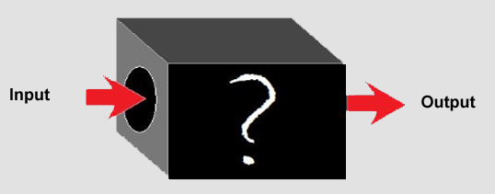
How to Systemize It?!
Previous works:
Think of it as black box
Systemize it based of input, outputs, function
Didn’t dive into the details enough

Slide 36
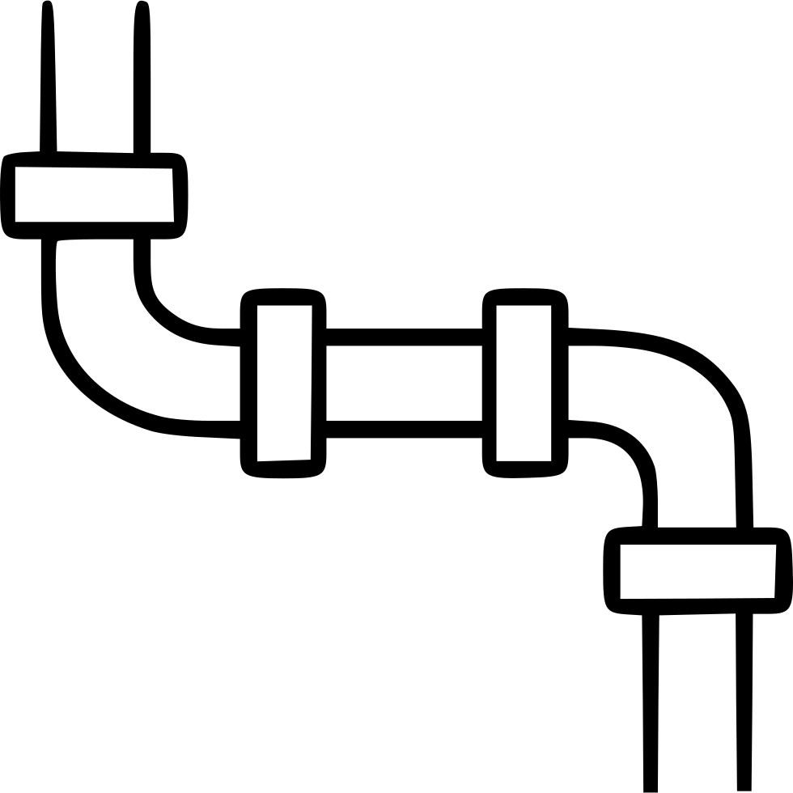
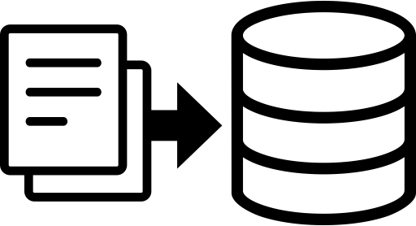
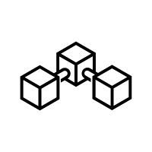
How to Systemize It?!
Put myself on data’s shoes
Blockchain

Slide 37
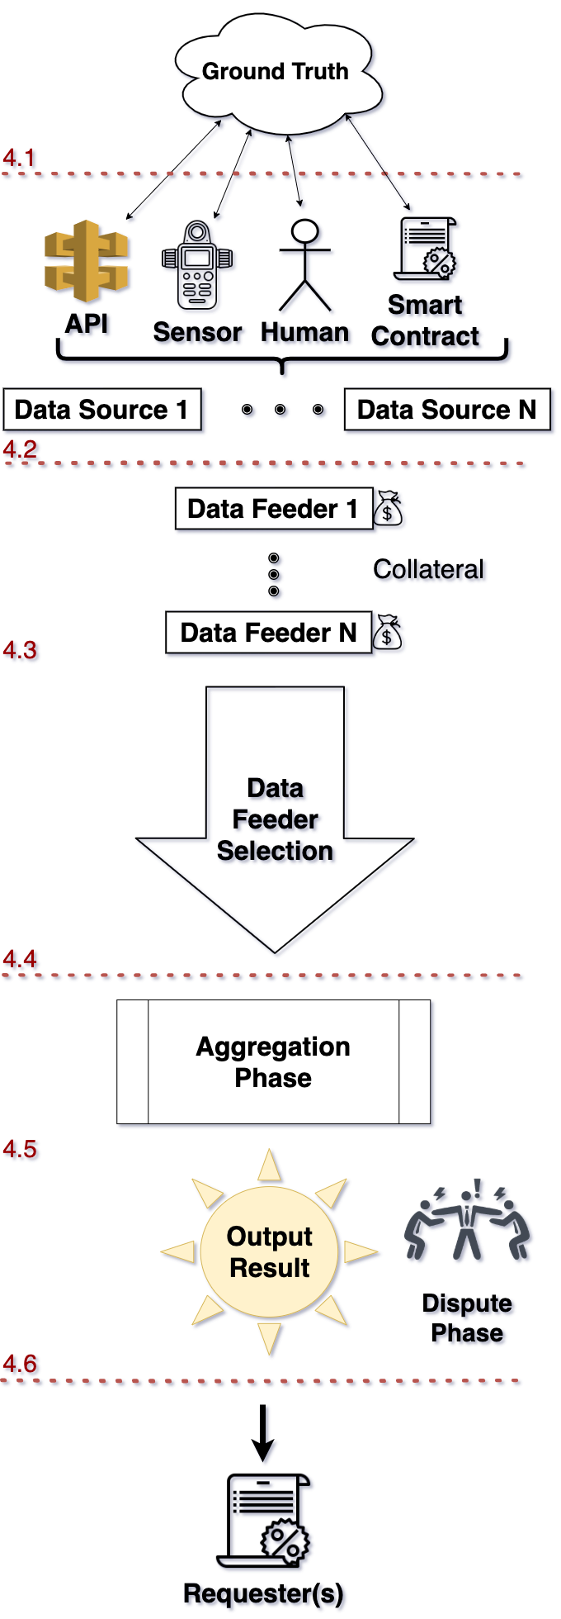
Oracle’s Modular Workflow
We break the design of an oracle system into modules
Each module can be on-chain or off-chain, or in
different order. But all oracles can be defined using
these modules

Slide 38
Oracle’s Modular Workflow
Ground Truth
Data Sources
Data Feeders
Selection of Data Feeders
Aggregation
Dispute Phase

Slide 39
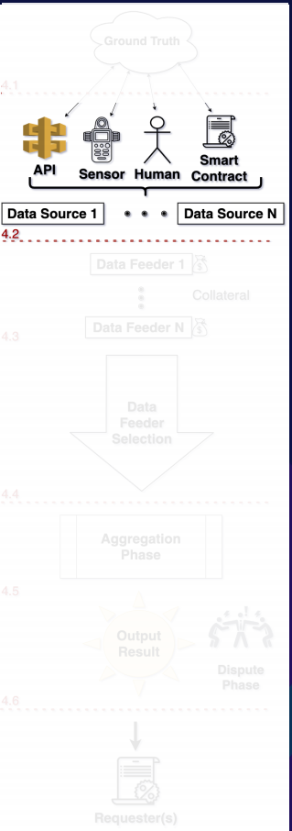
Data Sources
Passive entities that store and measure the representation of the ground truth.
Common types of data sources include:
Databases & API
Sensors
Humans
Smart contracts

Slide 40
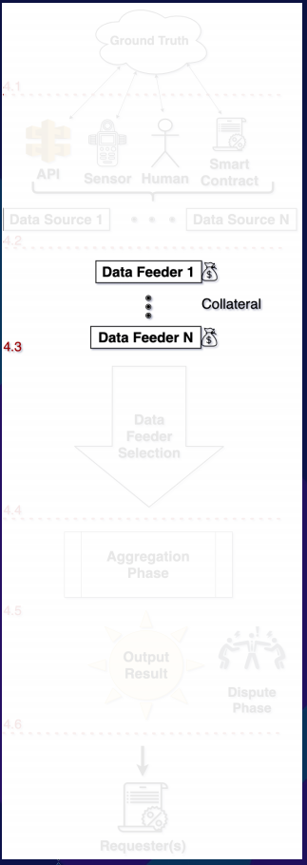
Data Feeders
Entities who gather and report the data from the source to the oracle system
Security Provisions:
Source Authentication
DECO, TLSNotary — HTTPS data
TownCrier — Intel SGX
Confidentiality

Slide 41
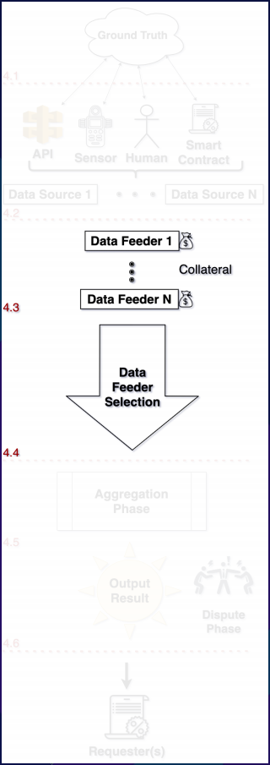
Selection of Data Feeders
Select legitimate data feeders and weed out the less
qualified participants
Centralized (Allowlist) selection
Decentralized (Allowlist) selection
Voting
Staking

Slide 42
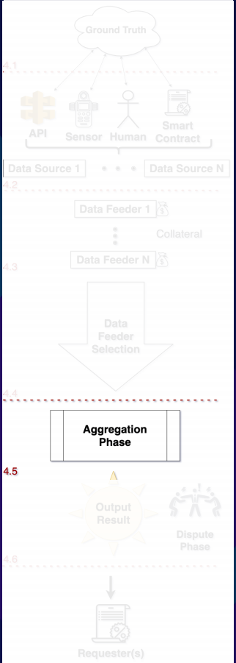
Aggregation Phase
The process of synthesizing the selected data feeds into one single output
Statistical measures
Mean / Median / etc
Random selection

Slide 43
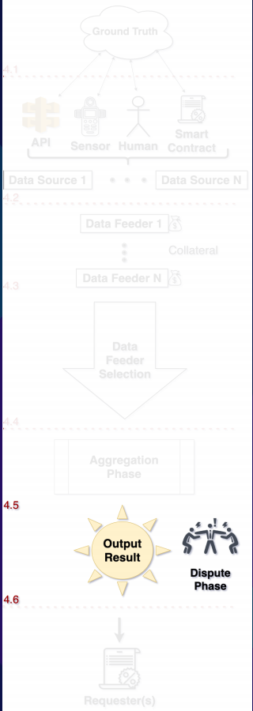
Dispute Phase
Safeguards the quality of the final output and give the
stakeholders a chance to mitigate inclusion
of wrong data
Provider-level v.s.
Data-level vetting

Slide 44
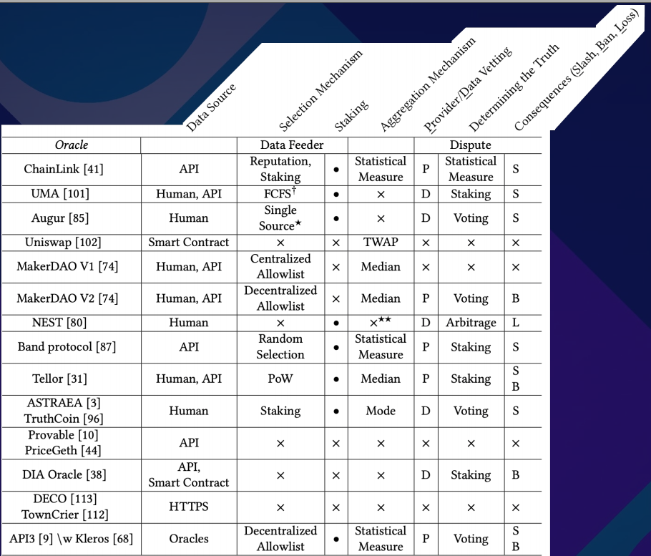
Classification of the current Oracles

Slide 45
Take-Aways
Oracles use their governance token for staking, two necessary conditions:
The market capitalization of the token stays material
The token is evenly distributed.
Diversity in software promotes resilience in the system.
Notes:
If one project is the main Oracle, failure within that one project causes cascading failure across the ecosystem

Slide 46
Stablecoins and Synthetic Assets in DeFi
Payments in Blockchain Smart Contracts
Notes:
For the last part I will describe a set of applications in Ethereum named stablecoins and the risks regarding them.

Slide 47
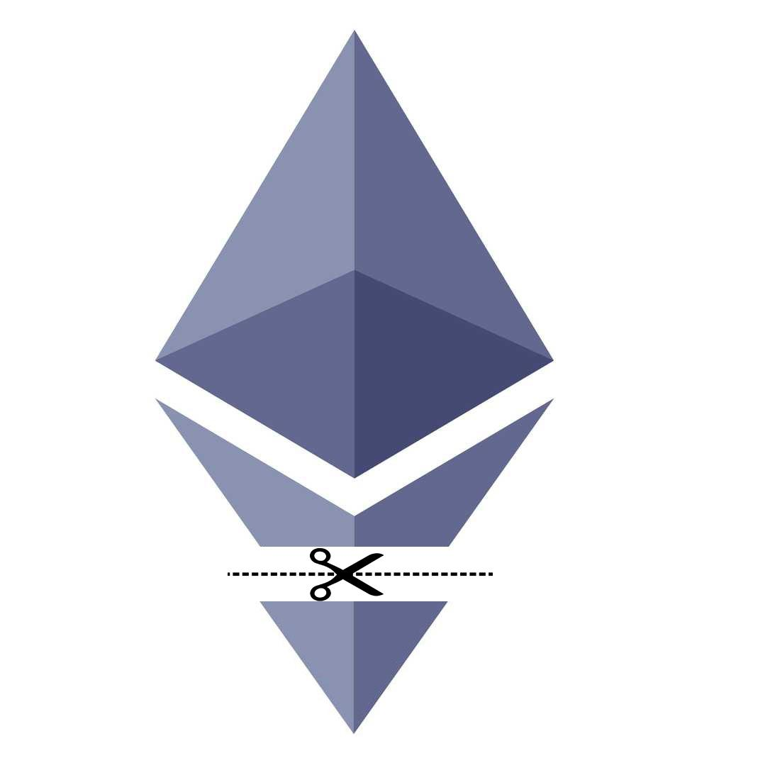

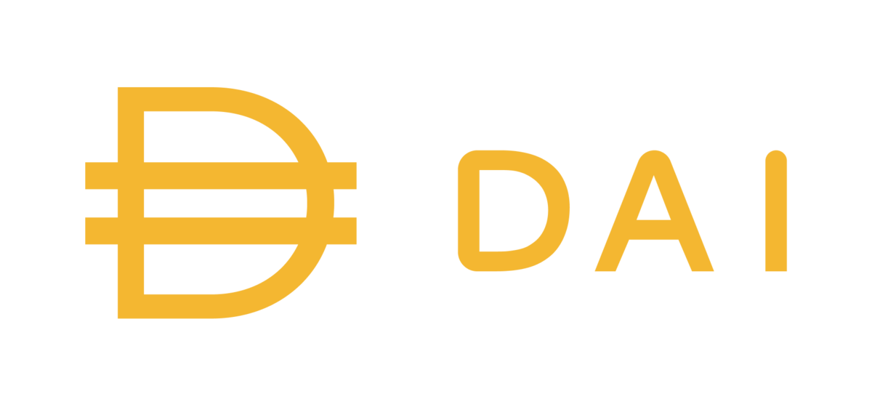

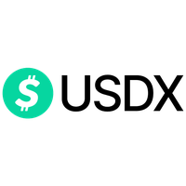



Black Coin (Peg)
1) Financial Analysis
Red Coin (Risk Absorber)
Notes:
There are a set of applications in Ethereum to bring other assets on the Ethereum blockchain. The main one is stablecoins which tries to bring us dollar to the Ethereum blockchain. In most of these applications they get Ether as collateral and have two positions in line as output. A black coin which supposed to be 1 dollar and a red coin which is the risk absorber. In this part we first financialy analyze these systems.

Slide 48
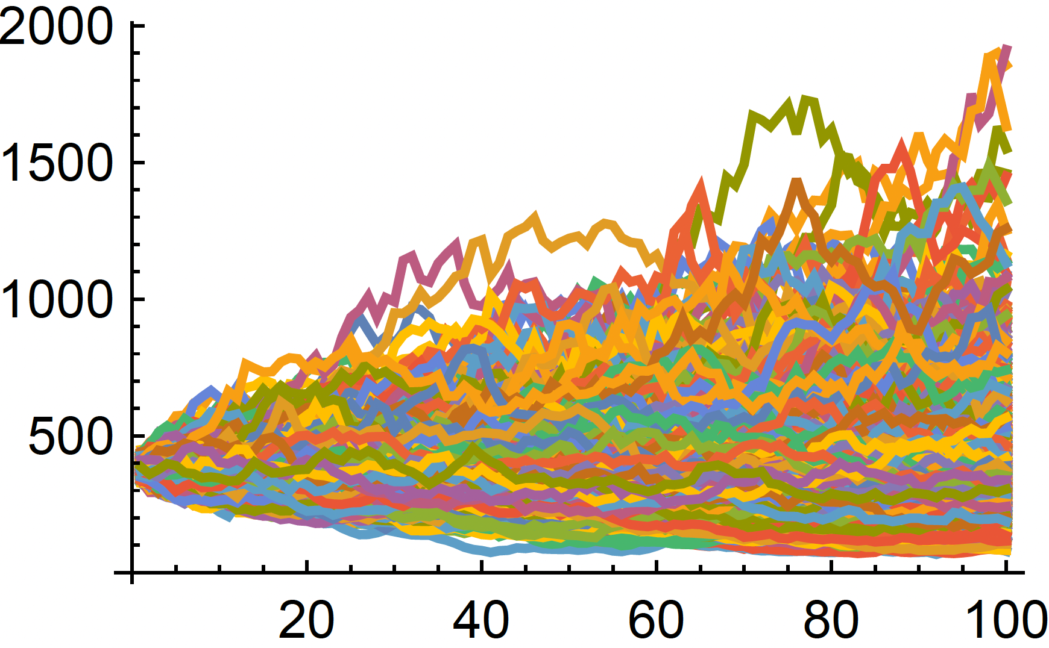
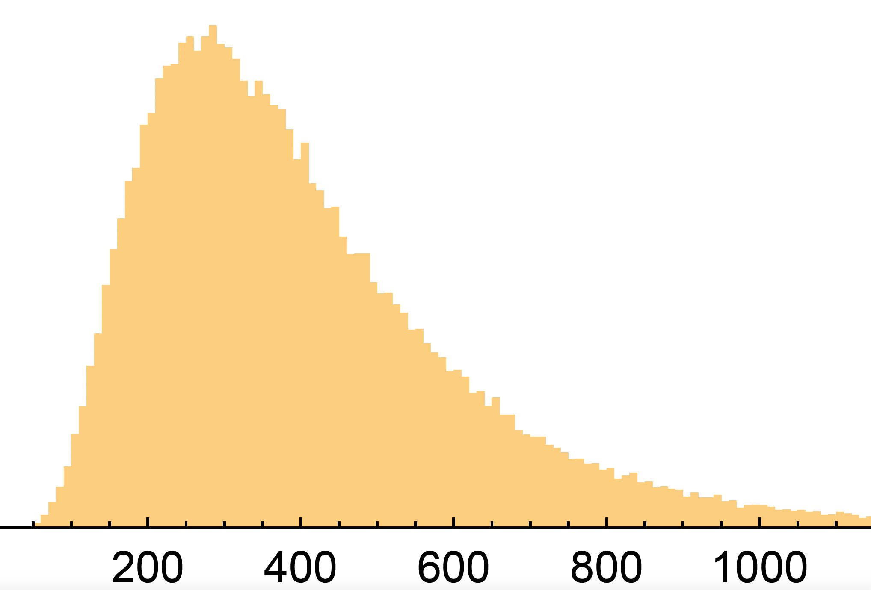
1) Financial Analysis
Expected Value for Black coins: $0.94
Not 1$
Results after
100 days
Geometric Brownian Motion (GBM)
Ad-hoc mechanism
for stabilization
Notes:
Using an stochastic process model named GBM and the price history of Ether, we predict 10 thousands of possible outcomes for the Ether price which we show in the left figure. The results of the ether price after 100 days has a log-normal distribution and expected value for our black coin for this analysis is point 94 but it supposed to be 1 dollar. So we need another ad hoc mechanisms to stabilize this asset

Slide 49
Black Coin (Peg)
1) Financial Analysis
2) Design Landscape
Red Coin (Risk Absorber)
Beyond Liquidation
Notes:
In the other part of the research we propose different ways to design a stable coin by adding different ad-hoc mechanisms such as liquidation.

Slide 50
Conclusion
Take-Aways from this thesis

Slide 51
Conclusions
Each component adds centrality
Against the sprit of blockchains
Add attack surfaces/security risks
Upgradeability
Immutability is oversold.
64% of contracts are controlled by centralized agents
Oracles
Chainlink is a single point of failure
Economic security of most of oracle systems depend on wrong assumptions
Stablecoins:
Hidden risks on the investor side that are hard to analyze

Slide 52
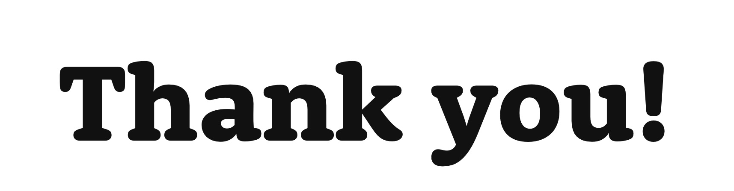

Any Question?
mehdi.salehi@concordia.ca
Notes:
Thank you for listening to this presentation and I'll be happy to answer questions.

